Slide 1
CS-GY 6313 B: Information Visualization
11/13/2024

Slide 2
Logistics
Assignment 4 due Nov 20 @ 11:59pm
Guest lecture moved to Dec 5:
Dr. David Saffo and Dr. Benjamin Lee @ JPMC
3D + immersive viz
Bring your laptop!
Today:
Misinformation + ethics
Narrative storytelling
User study crash course

Slide 3
Misinformation & Ethics

Slide 4
Misinformation
5 rules to not get mislead:
Is the author using the correct data and disclosing the source?
Are you reading too much into the graphic?
Are the data represented accurately?
Is the visualization showing an appropriate amount of data?
Is uncertainty relevant? If yes, is it shown?

Slide 5
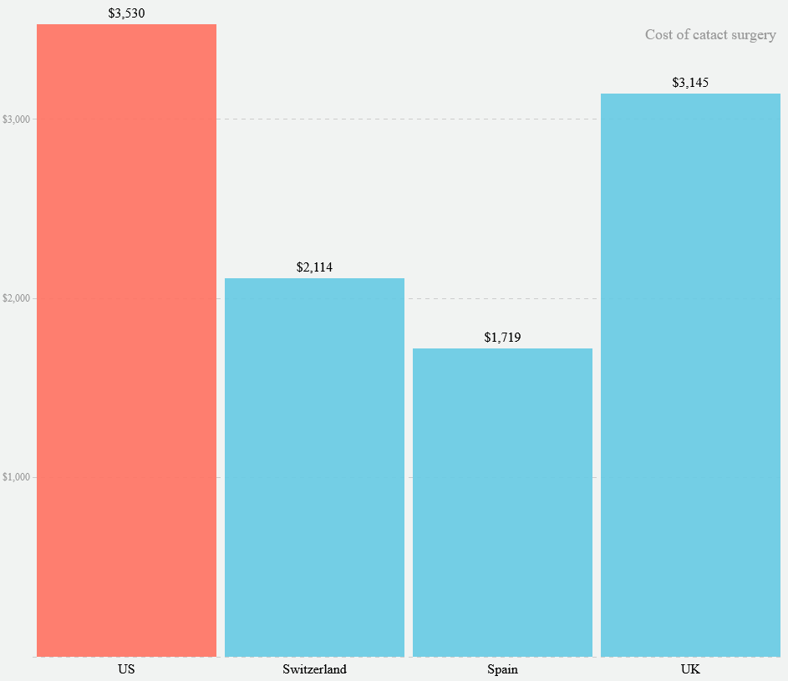
Misinformation
Is the author using the correct data and disclosing the source?
https://www.vox.com/a/health-prices#chart/9
Notes:
Salaries in USA and Spain are different (spain is about half of usa salary)
Lower salaries will drive down the prices of goods → purchasing power

Slide 6
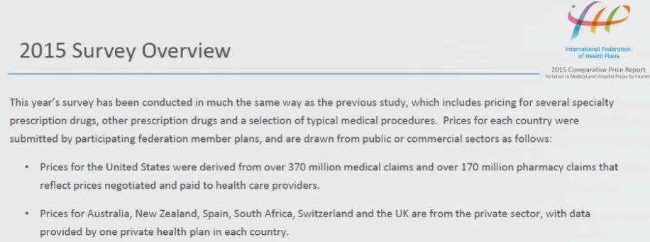
Misinformation
Is the author using the correct data and disclosing the source?
Notes:
Salaries in USA and Spain are different (spain is about half of usa salary)
Lower salaries will drive down the prices of goods → purchasing power

Slide 7
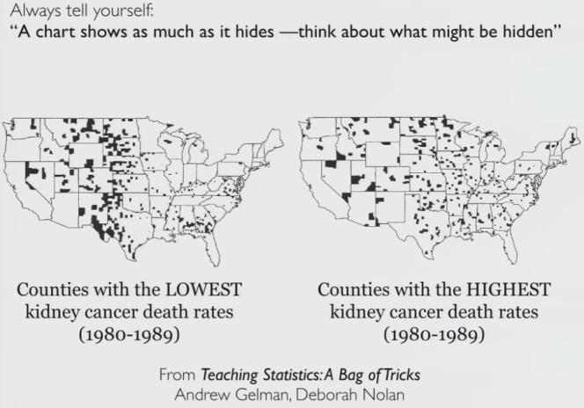
Misinformation
Are you reading too much into the graphic?
Notes:
People in rural areas probably walk more, have healthier diets from growing their own food, get more sunshine and higher quality air…
Highest rates are also rural
Variance is high within low sample sizes (population sizes in this case)

Slide 8
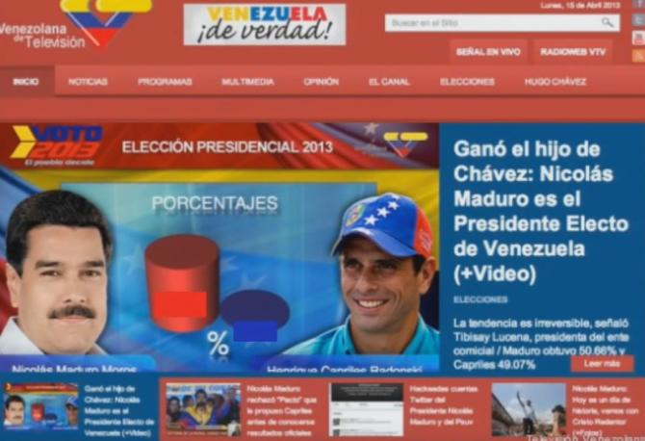
Misinformation
Are the data represented accurately?

Slide 9
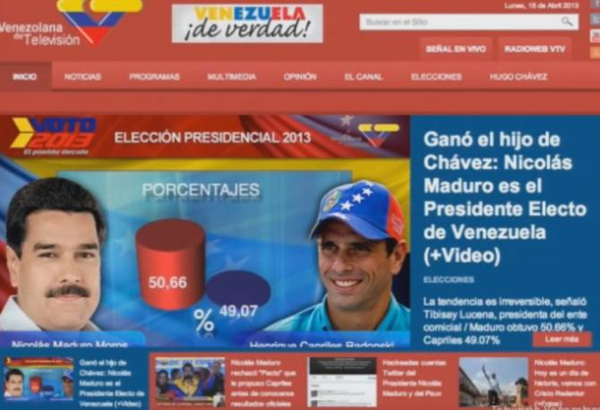
Misinformation
Are the data represented accurately?

Slide 10
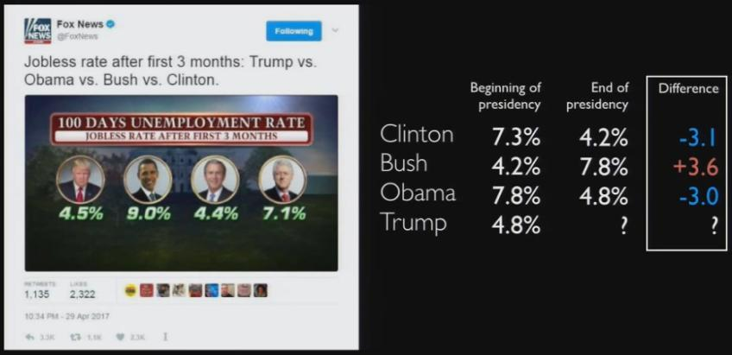
Misinformation
Is the visualization showing an appropriate amount of data?
Notes:
First 3 months is inherited from the last president, mostly
Show a comparison with their last 3 months

Slide 11
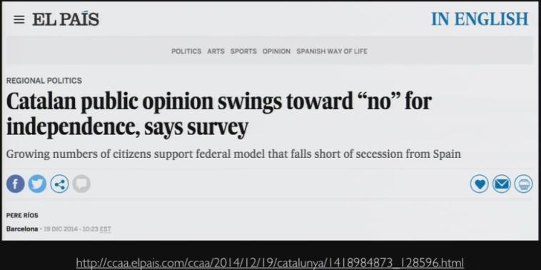
Misinformation
Is uncertainty relevant? If yes, is it shown?

Slide 12
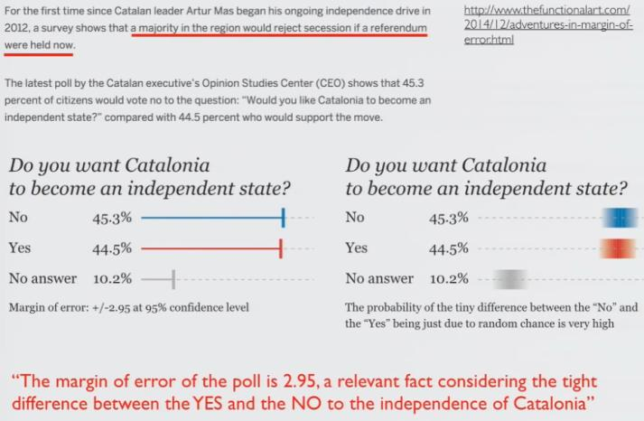
Misinformation
Is uncertainty relevant? If yes, is it shown?

Slide 13
Ethics
What is ethics?
“a set of moral principles, especially ones relating to or affirming a specified group, field, or form of conduct.” –Google
Ethics are not fixed
If possible, be up-front about your ethics
Morals are determined individually, laws are geopolitical
No single right way to do data viz
Several wrong ways!
Must avoid these wrong ways
Data are not neutral!

Slide 14
Ethics: Data Viz Process
Select topic, problem, or question
Acquire data
Clean data
Analyze data
Make viz…
Why is this study being done?
Who benefits from the outcome of this study?
Who might be harmed?
Am I the right person to do this research?
If appropriate, have I preregistered my research?
Notes:
Why is this study being done?
Will this research actually contribute to new understanding or change? It is very demoralizing to be studied and then have nothing come from it.
If using secondary data, do you have the data you need to really answer the research question?
Who benefits from the outcome of this study? Who might be harmed?
Is there a conflict of interest that might bias analysis/communication? This is a situation where confirmation bias might show up, both while framing the research question and while gathering the data.
Will the study exclude participants, thus preventing them from benefiting from research? (Ozeran, 2019)
Are participants being protected throughout the process?
Is this population over-burdened by research?
Am I the right person to do this research?
“What knowledge gaps do I have?” (Cogley, 2018a)
Have I built trust with this community?

Slide 15
Ethics: Data Viz Process
Select topic, problem, or question
Acquire data
Clean data
Analyze data
Make viz…
Exclusion because of research scope:
Focusing a study of heart attack symptoms on symptoms that are more common for men, like chest pain
Focusing a study of child cereal preference on healthy cereals but not accounting for nut allergies
Focusing a study of library satisfaction on physical spaces, ignoring distance students

Slide 16
Ethics: Data Viz Process
Select topic, problem, or question
Acquire data
Clean data
Analyze data
Make viz…
What choices were made about collection method, participant selection, questions included, etc.? What influenced those choices?
Are the people represented by the data being treated with dignity? Have they been included in the decision-making process? Are you minimizing the burden and risk placed on them?
Will the data you have answer your research question?
Have you cited the source of any secondary data?
Notes:
Collecting the data yourself:
“Do the people represented in this data have control over how it’s collected?” (Cogley, 2018b) How were they included in the data process? Can they opt out?
Are you collecting more data than you need? Or not enough?
One example of not having enough data: if your data breaks down by demographics but one group is a very small percentage of the population, you may have a small number of participants in that group and run the risk of either re-identifying them or misrepresenting them by having only a few people included in the sample. You may want to proactively oversample from these groups. If you do so, you may need to weight the analysis based on the known proportions of the population to re-balance when computing global averages.
What are you consciously not collecting? Why?
Note: sometimes not collecting certain demographics categories is important, and other times it perpetuates marginalization. For example, the citizenship question on the 2020 Census would have had a silencing effect, but failing to record gender and race in certain circumstances makes it impossible to identify bias experienced by subsets of the participants.
Do you have reason to believe the data you’re collecting will answer the question you’re asking?
Secondary data:
Who collected the data?
How was the data collected? In what context (setting, assumptions, limits, etc.)?
What options appeared in the survey instrument (drop down vs. free form)?
how subjective are the measures? (Cogley, 2019)
how is null recorded (Cogley, 2020)
can we collect data that does not fit our categories (D’Ignazio & Klein, 2016)
Ex. Patient records - for the care and treatment of a patient - patient may be reluctant to disclose information
Were participants included in the data process?
Who do I need to give credit to for collecting the data?

Slide 17
Ethics: Data Viz Process
Select topic, problem, or question
Acquire data
Clean data
Analyze data
Make viz…
Bias introduced by taking shortcuts:
Conducting psychology experiments only with students enrolled in introductory psychology courses, ignoring the bias that introduces in the population (age, gender, educational background, race/ethnicity, etc.)
Participant exclusion because focus group is held in the evening when nontraditional students might have caretaking responsibilities
Participant exclusion by advertising study only to certain listservs
Exploring community dynamics on Twitter but only looking at public tweets

Slide 18
Ethics: Data Viz Process
Select topic, problem, or question
Acquire data
Clean data
Analyze data
Make viz…
What assumptions are you making about the data? Are there other interpretations?
Are you removing any data from the analysis? Will that introduce systematic bias into the analysis?
Are you simplifying data for the analysis? How does the loss of that complexity influence your results? Are your participants still being well represented by the data?
Have you given appropriate credit to anyone who helped with data cleaning?

Slide 19
Ethics: Data Viz Process
Select topic, problem, or question
Acquire data
Clean data
Analyze data
Make viz…
Problems related to data aggregation:
Survey respondents from underrepresented minorities are often grouped together to avoid identification, but this decision also leads to the erasure of these groups.
Students with low GPAs are grouped together in a category (“<3.5 GPA”) even though over 85% of students in this category have a GPA under 2.5

Slide 20
Ethics: Data Viz Process
Select topic, problem, or question
Acquire data
Clean data
Analyze data
Make viz…
Are you applying appropriate analysis methods / statistical tests to the data you have?
Are you fully exploring data interactions and alternative explanations?
Do you know enough about the data to interpret the results?
Are you explicitly declaring all of the limitations of this analysis?
Have you given appropriate credit to anyone who helped with data analysis?

Slide 21
Ethics: Data Viz Process
Select topic, problem, or question
Acquire data
Clean data
Analyze data
Make viz…
Bias introduced by assumptions:
Misunderstanding a hashtag that is meant to indicate sarcasm and, thus, coding a series of tweets as having positive sentiment instead of negative
Ignoring gender because it wasn’t expected to be an issue, only later to realize that gender has an effect on your question-of-interest
Seeing an anomalous 50% drop in counts as a data collection problem, when really there was a global pandemic that year

Slide 22
Ethics: Data Viz Process
Select topic, problem, or question
Acquire data
Clean data
Analyze data
Make viz…
Ask these questions of collaborators or yourself for each step of the process
Show the process
Give credit
Fill in personal knowledge gaps by consulting literature, subject experts, and, if human-subject data is involved, work put out by members of the community being visualized

Slide 23
Ethics: Know your audience
Both intended and unintended audiences
Conscious of historical context and what may come after (datapractices.org)
People can feel recognized, misrecognized, and unrecognized in data visualization (Naerland, 2020)
Work towards increasing benefit and preventing harm (datapractices.org)
What gaps might our audience have and what narrative needs to be added? (Cogley, 2018a)
Does the visualization empower the audience? (D’Ignazio & Klein, 2016)
Notes:
(Naerland, 2020) - Media constantly mirror back images of their audiences - important source for recognition - people can feel recognized, misrecognized, and unrecognized in data visualization
“Who will be using the visualization? To what end? Will decisions be made that can affect human welfare, whether mental, physical, financial, etc.? Will sharing this visualization violate anyone’s privacy, or right to self-determination? How might the visualization be used or misused for political purposes?” (Ozeran, 2019)
“promote empathy for the people whom the data represents. For example, if you are representing death, a minimalist, “objective” visualization may not be the best way to respect those people. Second, promote empathy for your audience. Make your visualization accessible, usable, and understandable. Provide ways for them to learn more based on questions that may arise from viewing your visualization.” (Ozeran, 2019)

Slide 24
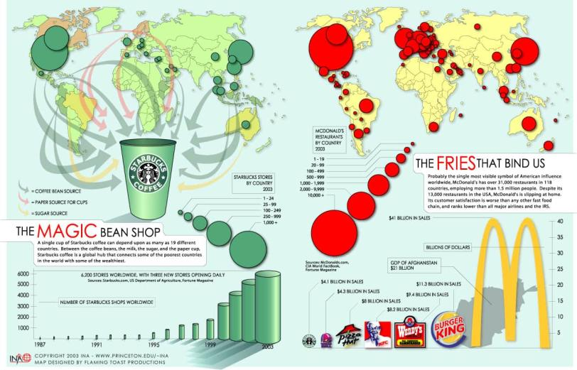
The Fries that Bind Us and The Magic Bean Shop
https://www.princeton.edu/~ina/infographics/starbucks.html
Notes:
Country colors almost entirely invisible, and confusing that the light green color isn’t really a data color, just the default country color; possible issue with red/green color blindness
Arrows are unclear, hard to follow, and the contrast is likely too low; possible issue with red/green color blindness
The circles cover up the map
Size of circles not proportionate (legend suggests data were binned, so size isn’t continuous, and the circle area doesn’t seem to represent well either the low value of the bin or the high value)
Size of logos not proportionate (distorts the data by changing both width and length instead of just length, like a bar chart)
3D chart -- makes it harder to read, also distorts the data by changing volume instead of just length

Slide 25
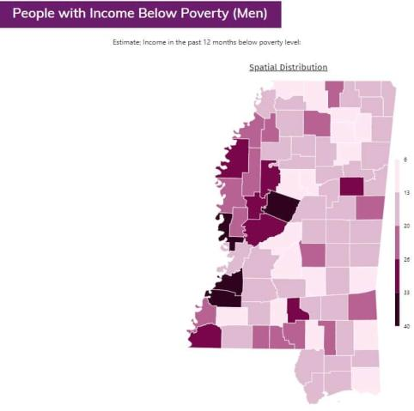
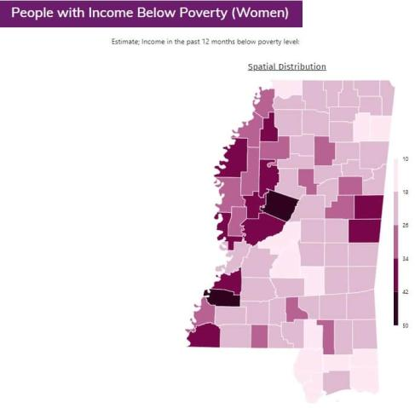
Mapping Census Data: Poverty and Gender
Note: Maps display percent of each demographic group below poverty by county. Poverty thresholds vary depending on the size of the family unit and the number of children under 18 years in the family. In 2018, the poverty threshold for an individual under 65 years is $12,784. For a family of four (two parents, two children) the threshold is $25,465. For each additional child, the threshold increases by between $3,000 and $5,000. The thresholds for each year since 1978 can be found here: https://www.census.gov/data/tables/time-series/demo/income-poverty/historical-poverty-thresholds.html
Notes:
Generally, the distribution across counties seems similar for men and women, with women experiencing higher levels of poverty overall and in some specific counties
The maps and note are missing specifics about the source of the data. Is it decennial Census? American Community Survey? From what year? Also missing north arrow, scale bar, label identifying the state as Mississippi.
For context, we might need to know the general population density for each county.
Advanced: the data classification method used results in different scales for each map, making it more difficult - or not possible - to make direct comparisons across groups

Slide 26
Mapping Census Data: Poverty and Gender
Challenging assumptions:
Did we know enough about the history of Mississippi to be able to interpret the relationship between poverty and gender?
Should the map creator(s) have investigated the intersection of race and gender as it relates to poverty in Mississippi?
Examining positionality: Who is benefitting from this work?
“Mapping inequality is not impactful in and of itself. Must continuously ask ourselves: are our practices creating the knowledge by which communities can build power?” (Koli 2019)
Select topic, problem, or question
Acquire data
Clean data
Analyze data
Make viz…
Notes:
ask which step of the data visualization process relates to each assumption

Slide 27
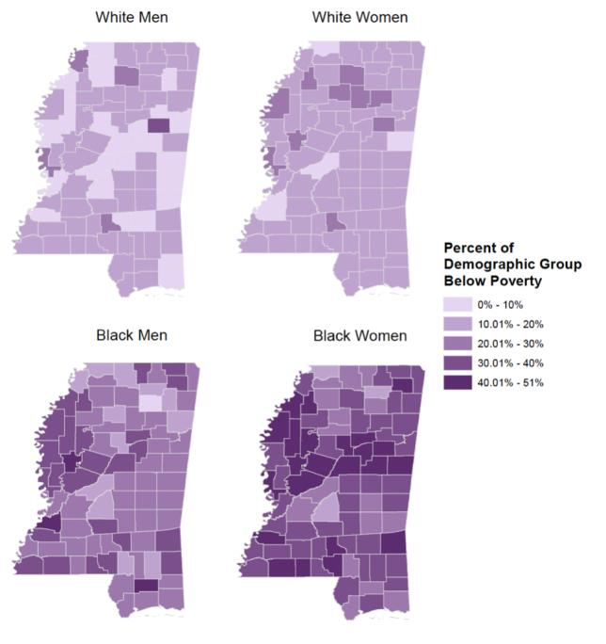
Mapping Census Data: Poverty and Gender
Source: 2012 ACS 5-year estimates. Koli, F. “(Un)Privileging the Map: A Community Collaboration in Understanding Economic Security.” Paper presented at the MAPPING (IN)JUSTICE SYMPOSIUM: Digital Theory + Praxis For Critical Scholarship. Fordham University / November 7-9 2019
Notes:
Discussion questions:
Now looking at poverty stratified by both race and gender, what do the visualizations reveal?
Which group is most affected by poverty across Mississippi?
Taking an intersectional approach looking at poverty by both race and gender reveals that Black women are most affected by poverty across Mississippi. It highlights the limitations of exploring gender absent race. Black men face higher rates of poverty than white women, but this would be rendered invisible if aggregated with data on white men
The power granted to maps and data, which in many cases can and has led to the reinforcement of oppressive structures, is also the reason why they have the potential to be used to bring attention to those oppressive structures.

Slide 28
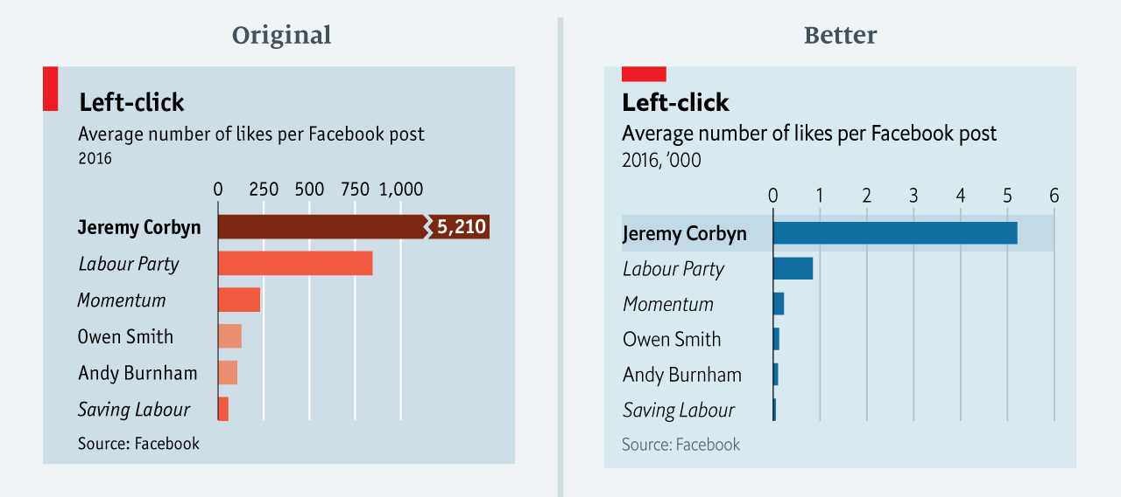
The Economist visualizations
?
https://medium.economist.com/mistakes-weve-drawn-a-few-8cdd8a42d368
Notes:
Message the chart is trying to get across: How far Jeremy Corbyn surpasses other British political parties and candidates in the number of Facebook likes.
What is misleading about this chart or preventing this message from getting across: The truncated scale.
Other improvements made to the chart: move to a single color for the bars
Other things to note: Potential confusion of thousands notation in better chart

Slide 29
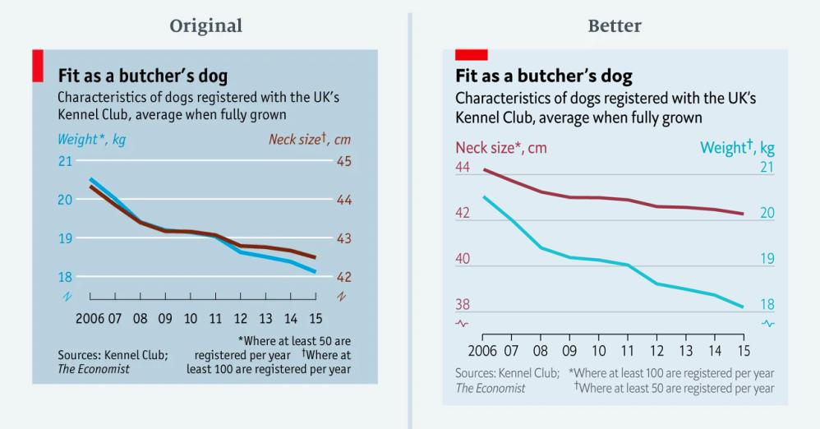
The Economist visualizations
?
https://medium.economist.com/mistakes-weve-drawn-a-few-8cdd8a42d368
Notes:
Message the chart is trying to get across: Neck size and weight dogs registered with the UK’s Kennel Club are decreasing at the same rate
What is misleading about this chart or preventing this message from getting across: Forced relationship by selecting scales. Issues of indexing, starting point of a scale.
Note: this might be difficult to pick out. The way to see the difference is look at difference in percentage

Slide 30
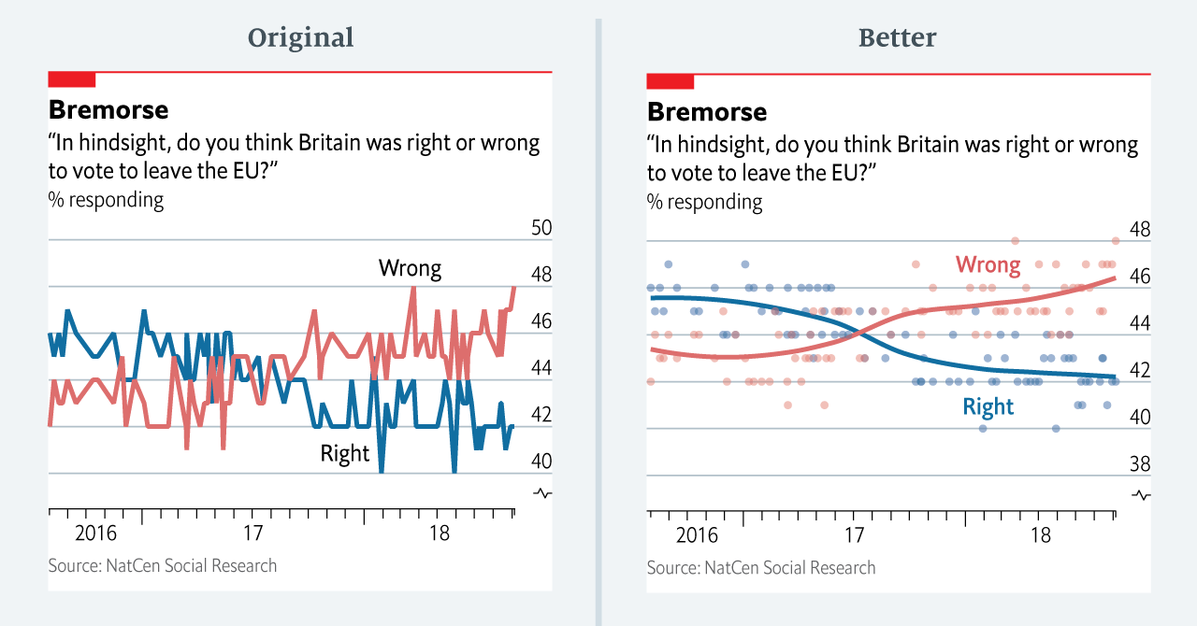
The Economist visualizations
?
https://medium.economist.com/mistakes-weve-drawn-a-few-8cdd8a42d368
Notes:
Message this chart is trying to get across: Increasing number of respondents believe it was wrong for Britain to leave the EU, decreasing number of respondents believe it was right for Britain to leave the EU
What is misleading about this chart or preventing this message from getting across: Hard to see the general trend with the line chart type, overemphasizes the smaller fluctuations
Their software was not advanced enough at the time

Slide 31
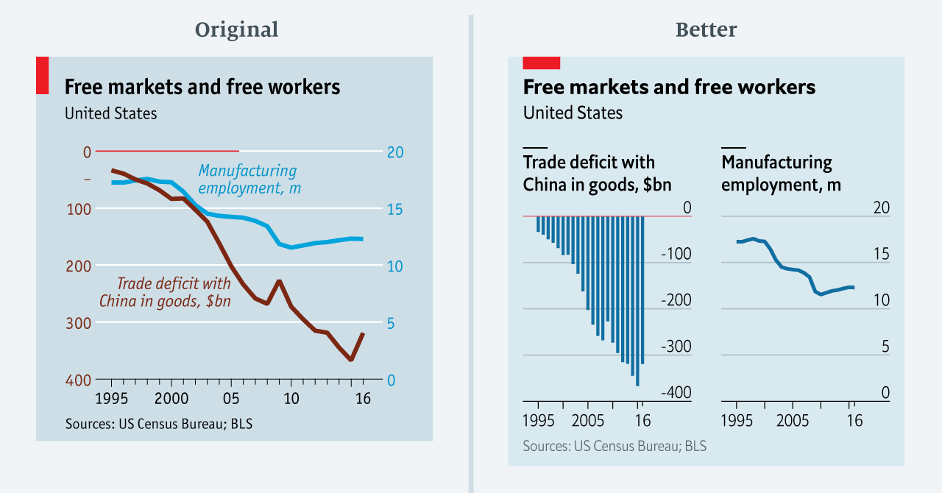
The Economist visualizations
?
https://medium.economist.com/mistakes-weve-drawn-a-few-8cdd8a42d368
Notes:
Message this chart is trying to get across: Relationship between trade deficit with China and manufacturing employment, trade deficit is increasing while manufacturing employment is decreasing
What is misleading about this chart or preventing this message from getting across: Difficult to read because left axis is negative and reads top to bottom, where the right axis reads from bottom to top

Slide 32
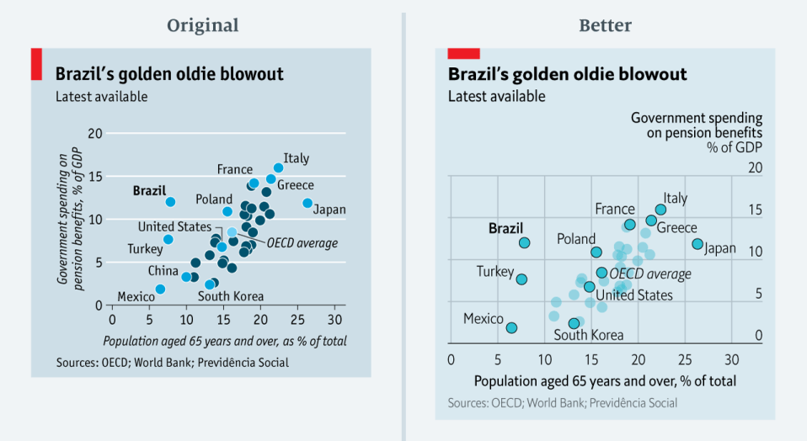
The Economist visualizations
?
https://medium.economist.com/mistakes-weve-drawn-a-few-8cdd8a42d368
Notes:
Message this chart is trying to get across: Brazil is paying a lot in pension considering it has a small portion of the population over 65, with other countries highlighted for comparison
What is misleading about this chart or preventing this message from getting across: color (specifically hue) implies there are different groups when there are no categories, multiple colors are distracting
Something to note: Inclusion of both gridlines to better highlight the intersection between the age and spending, why were these countries chosen to be labeled?

Slide 33
Storytelling and narratives

Slide 34
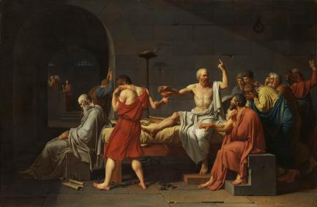

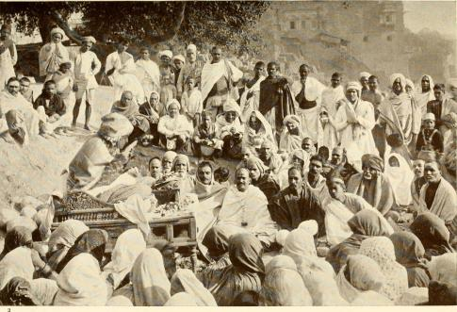


Storytelling
As old as mankind…

Slide 35
Storytelling
People tell stories
Words tell stories
Images tell stories
Comics tell stories
Movies tell stories

Slide 36
Narrative storytelling
narrative (n): An account of a series of events, facts, etc., given in order and with the establishing of connections between them.
Effective story-telling “require[s] skills like those familiar to movie directors, beyond a technical expert’s knowledge of computer engineering and science.” - Gershon & Page ‘01

Slide 37
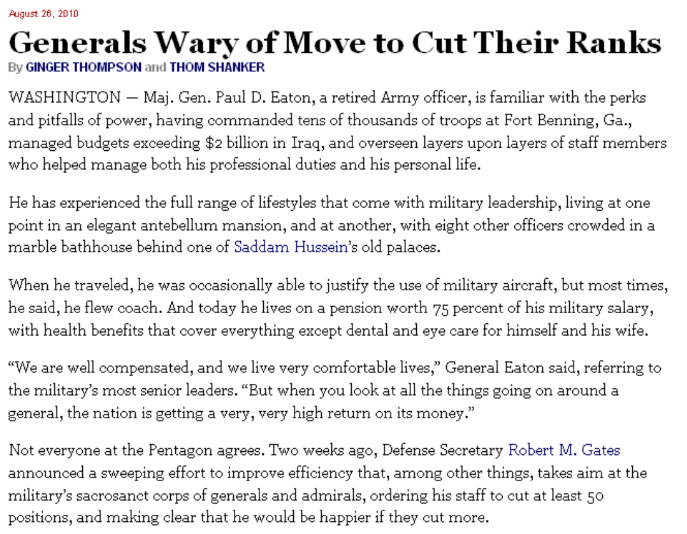
Storytelling

Slide 38
Storytelling
Anecdotal lead

Slide 39
Storytelling
Nutshell paragraph

Slide 40
Visual narration
How do we use visuals to guide the viewer in a similar way as is done in text?

Slide 41
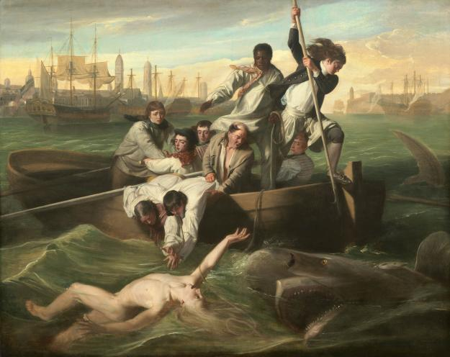
Visual narration
Watson and the Shark by John Singleton Copley

Slide 42
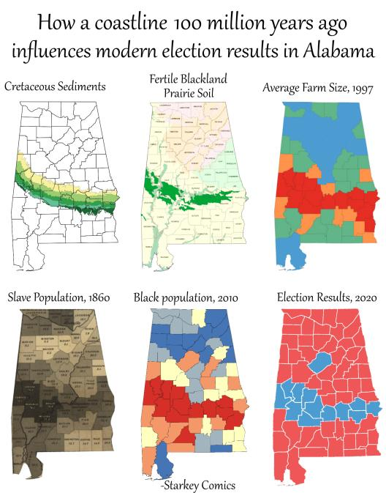
Storytelling with data
https://starkeycomics.com/2021/06/11/how-a-coastline-100-million-years-ago-influences-modern-election-results-in-alabama/
https://encyclopediaofalabama.org/article/cretaceous-period-in-alabama/
https://en.wikipedia.org/wiki/Black_Belt_(region_of_Alabama)
Notes:
100 million years ago

Slide 43
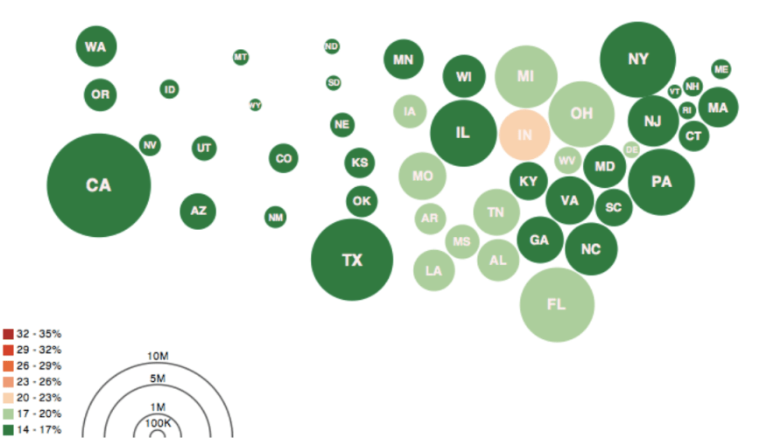
Storytelling with data
Obesity Map Vadim Ogievetsky

Slide 44
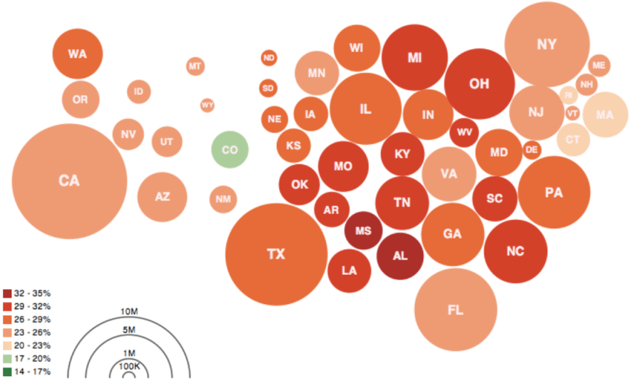
Storytelling with data
Obesity Map Vadim Ogievetsky

Slide 45
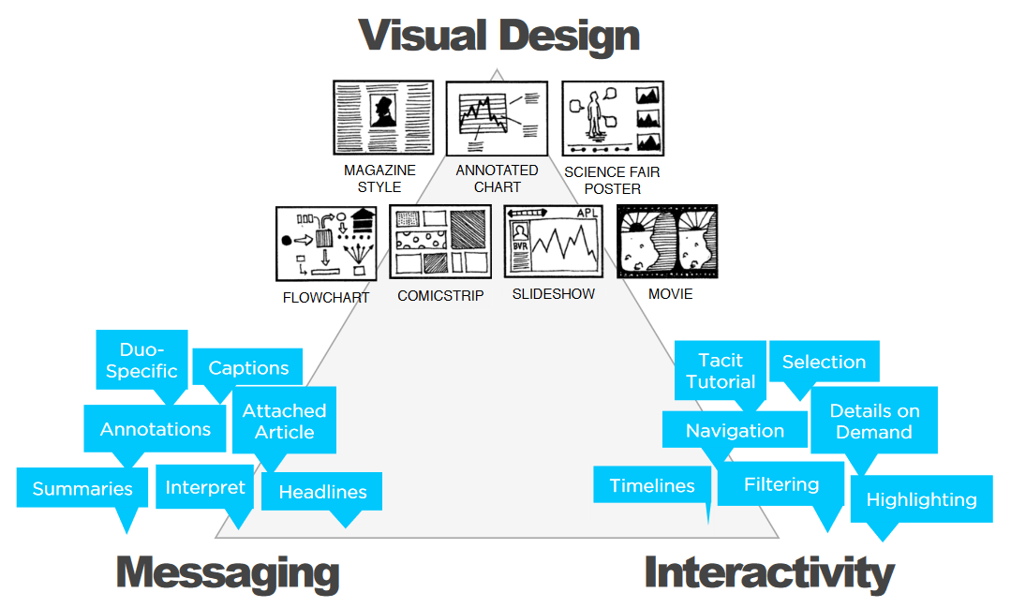
Narrative Visualization Techniques
Segel, Edward, and Jeffrey Heer. "Narrative visualization: Telling stories with data." IEEE transactions on visualization and computer graphics 16.6 (2010): 1139-1148.

Slide 46

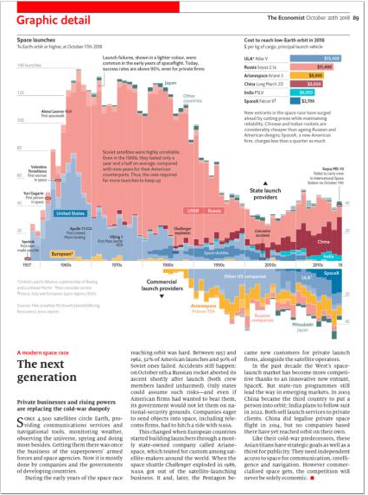
Magazine Style
Single frame
Lots of text!
Usually static

Slide 47

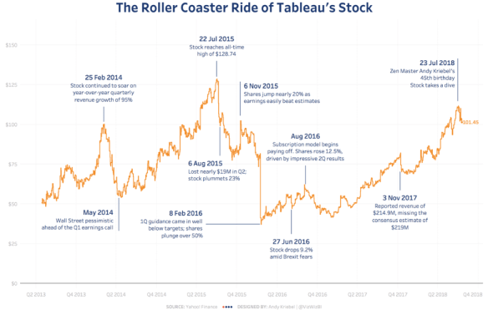
Annotated Chart
Text overlayed on the viz
Highlight key events and points of interest
Don’t obscure other parts of the data!
Brief, informative descriptions
Annotations create a reading order
Depends on the viz type
Don’t include too many annotations

Slide 48

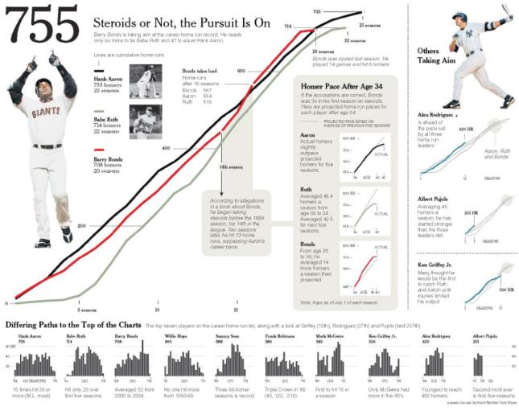
Partitioned poster
Partitions define different aspects of the data
Consistent ordering of elements in each partition
Less overhead when moving to a new partition
Reading order defined by size/color/bolding/image content of elements
Smaller charts on bottom are less important
Arrows help to guide the reading order

Slide 49

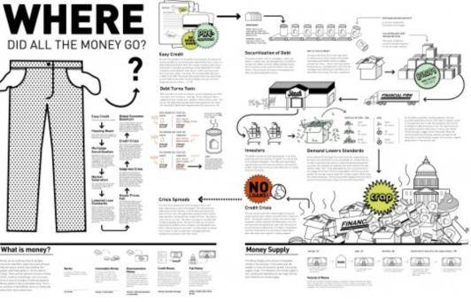
Flow chart
Maps a complex process/system into digestible components
Clear ordering
Obvious entry point (title, large icons)
Clear progression (arrows)
Top-bottom or left-right

Slide 50

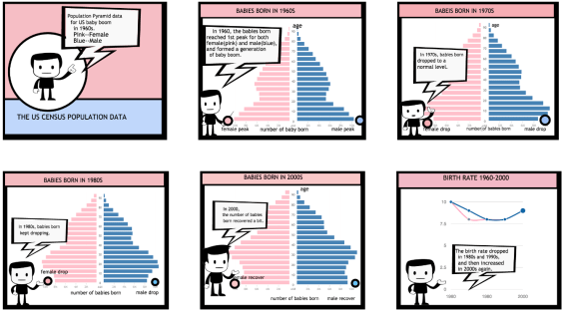
Comic Strip
Directly uses a comic strip format
Very familiar, easy to understand, and memorable
Salient visual elements
Comics are usually simple
Direct narration on each panel (act like annotations)
More approachable for a wide audience
Can be difficult to create
Requires some artistic skills
Not suitable for strict professional settings
Can be distracting
Can oversimplify data
Zhao, Zhenpeng, Rachael Marr, and Niklas Elmqvist. "Data comics: Sequential art for data-driven storytelling." tech. report (2015).

Slide 51

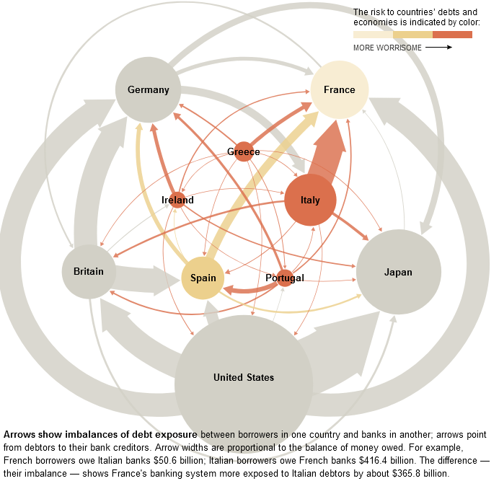
Slide show
Utilizes discrete stages of viz
Move through the stages one by one
Very clear sequence (forced, usually)
More appropriate for professional settings
Each slide (view) can implement other storytelling techniques (e.g. partitioned poster)
Can enable user-driven exploration (user decides which slides to look at for how long)
Especially good for cause-and-effect relationships
https://archive.nytimes.com/www.nytimes.com/interactive/2011/10/23/sunday-review/an-overview-of-the-euro-crisis.html

Slide 52

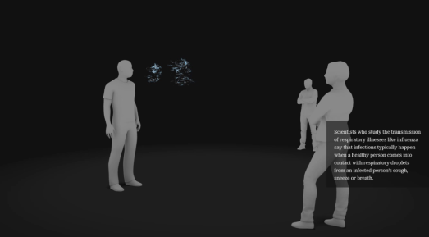
Film/video/animation
Uses motion!
Especially good for temporal data
Can be very engaging/immersive for viewers
Also allows for audio!
Electronic only…
https://www.nytimes.com/interactive/2020/04/14/science/coronavirus-transmission-cough-6-feet-ar-ul.html

Slide 53
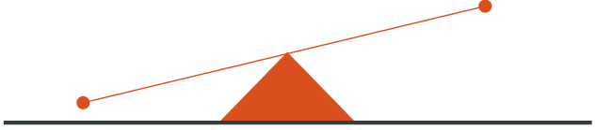
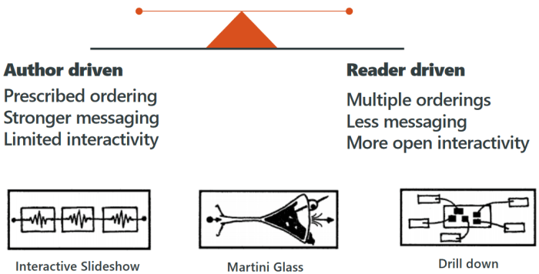
Level of Guidance Control
https://archive.nytimes.com/www.nytimes.com/interactive/2013/10/09/us/yellen-fed-chart.html

Slide 54
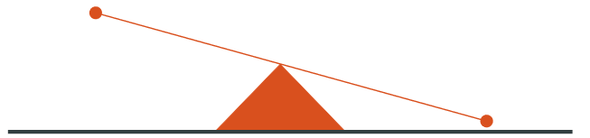
Level of Guidance Control
https://www.washingtonpost.com/wp-srv/special/world/north-korean-prison-camps-2009/
(need Flash)

Slide 55
Level of Guidance Control

Slide 56
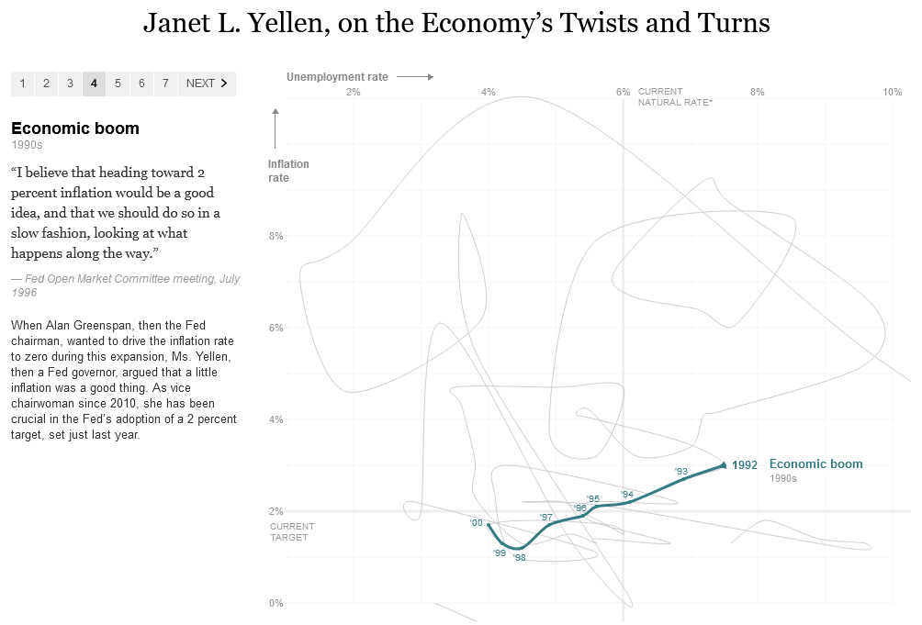
Narrative Visualization Techniques: Stepper
Steppers
Controlled trajectory through the data
Carefully controlled views of the data
https://archive.nytimes.com/www.nytimes.com/interactive/2013/10/09/us/yellen-fed-chart.html

Slide 57
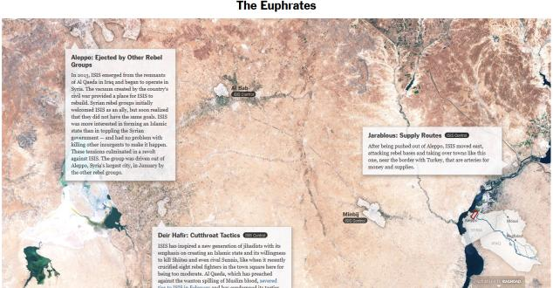
Narrative Visualization Techniques: Scrollytelling
Scrollytelling
Similar to steppers
use scroll wheel instead
https://www.nytimes.com/interactive/2014/07/03/world/middleeast/syria-iraq-isis-rogue-state-along-two-rivers.html

Slide 58
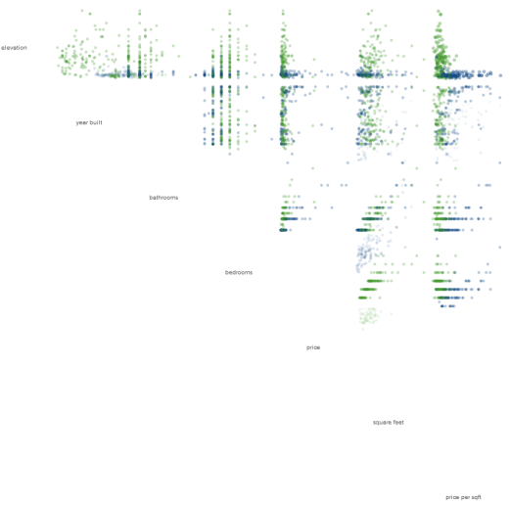
Narrative Visualization Techniques: Scrollytelling
Scrollytelling
Similar to steppers
use scroll wheel instead
http://www.r2d3.us/visual-intro-to-machine-learning-part-1/

Slide 59
Narrative Visualization Techniques
Discrete vs continuous
Stepper pros:
Very clear
Very precise control
Scrollytelling pros:
Lightweight
Easy to keep progressing
More engaging (?)
Implementation:
Do it yourself: monitor scroll position → element positions
https://bost.ocks.org/mike/scroll/
https://vallandingham.me/think_you_can_scroll.html
Libraries:
https://idyll-lang.org/gallery

Slide 60
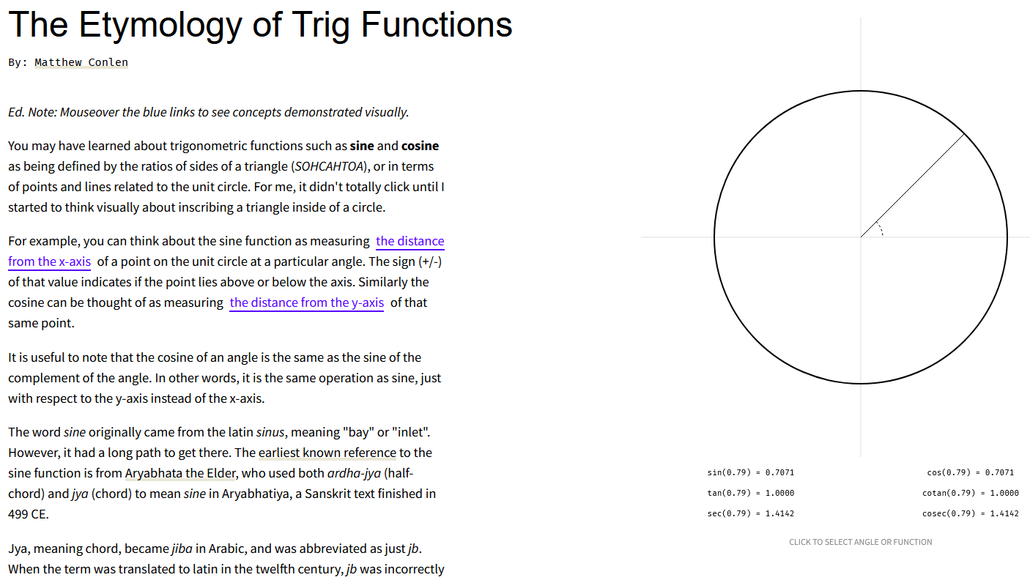
Narrative Visualization Examples
https://mathisonian.github.io/trig/etymology/

Slide 61
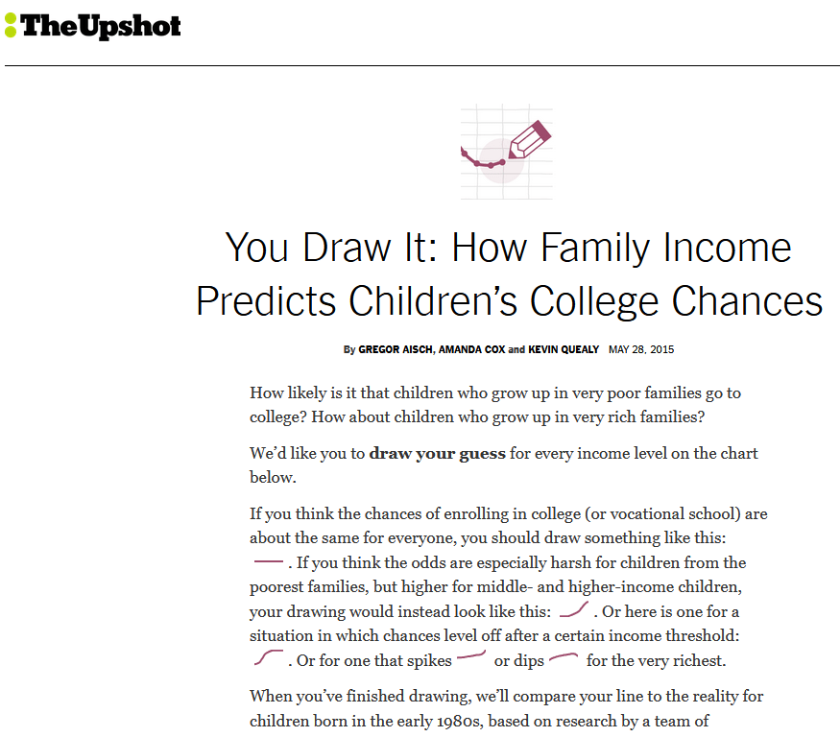
Narrative Visualization Examples
https://www.nytimes.com/interactive/2015/05/28/upshot/you-draw-it-how-family-income-affects-childrens-college-chances.html

Slide 62
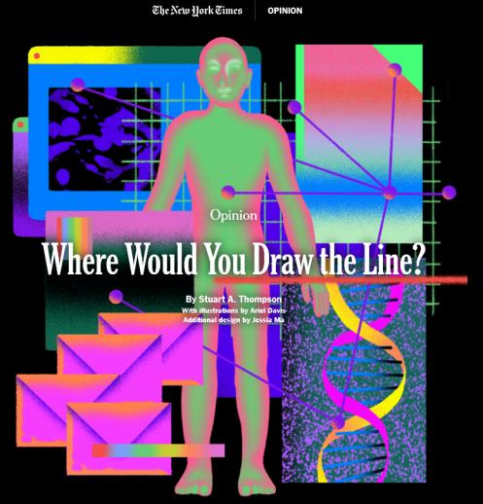
Narrative Visualization Examples
https://www.nytimes.com/interactive/2019/04/10/opinion/privacy-survey.html

Slide 63
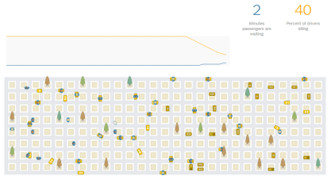
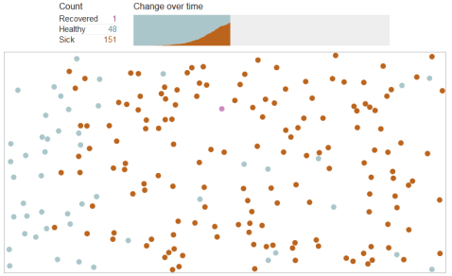
Narrative Visualization Examples: simulation
https://www.nytimes.com/interactive/2017/04/02/technology/uber-drivers-psychological-tricks.html
https://www.washingtonpost.com/graphics/2020/world/corona-simulator/
https://projects.fivethirtyeight.com/parole-assessment-simulator/

Slide 64
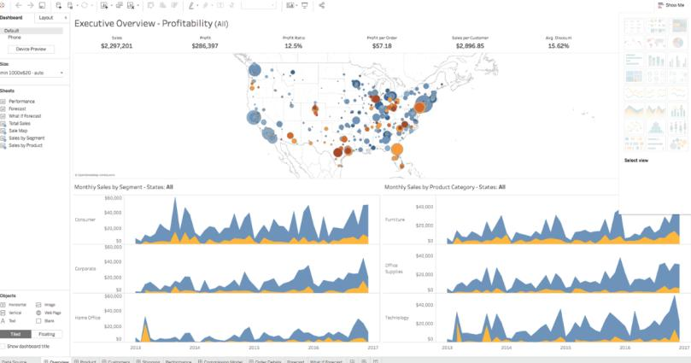
Chart Sequence Models
Data are often shown as a series of charts
How do we evaluate different orderings of charts?

Slide 65
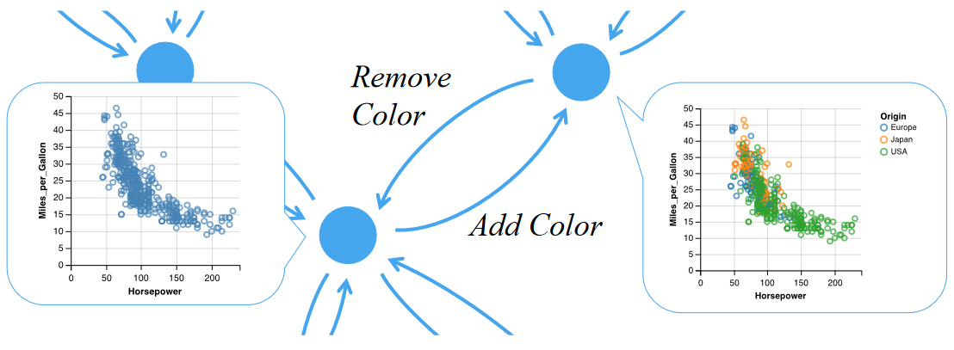
Chart Sequence Models
Kim, Younghoon, et al. "Graphscape: A model for automated reasoning about visualization similarity and sequencing." Proceedings of the 2017 CHI conference on human factors in computing systems. 2017.

Slide 66
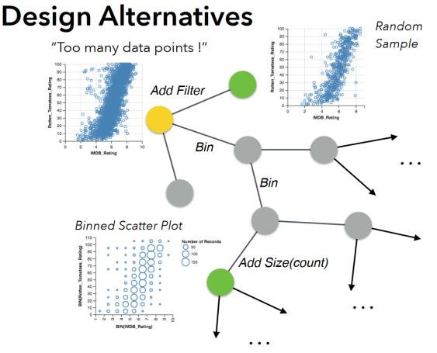
Chart Sequence Models: Applications
Kim, Younghoon, et al. "Graphscape: A model for automated reasoning about visualization similarity and sequencing." Proceedings of the 2017 CHI conference on human factors in computing systems. 2017.

Slide 67
Break Back at 1:07pm

Slide 68
User Study Crash Course

Slide 69
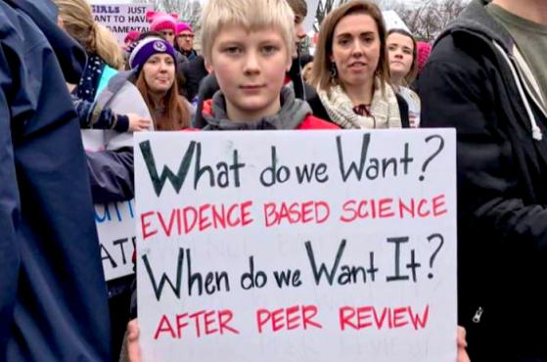
Empirical Research
We want to find an answer
Need data!
Run empirical studies to collect this data
https://twitter.com/LDMay/status/822922129637330944

Slide 70
What is science?
Both knowledge and a process
Establish and organize facts → body of knowledge
Facts should be falsifiable
Make predictions
Validate models

Slide 71
Is computer science science?
Sometimes!
Math
Engineering
Art
Psychology
When appropriate, we would like it to be science
Pretty efficient way of getting things done
We are historically not great at this
Random sample of ACM papers in 1993: 40% with claims that needed empirical evidence had none – Vs. 15% in optical engineering, etc. – (Tichy et al., 1995)

Slide 72
Empirical Research for viz
Why?
Validate visualization effectiveness
Identify usability issues
Gather user feedback
How?
Systematic and controlled
Different kinds of user studies
Exploratory studies
Observational studies
Hypothesis testing
Goals:
Representation and modeling: learn something true about a phenomenon
Generalizability: do your findings apply beyond the specific study?

Slide 73
Empirical Research for viz
Define a research question.
What do you want an answer to?
Identify a target audience
This defines your participant pool that you will recruit
Does your target audience have specialized knowledge or unique characteristics?
What are your outcome variable(s)?
Task completion time
Information retention
User satisfaction
How will you measure outcome(s)?
“Think aloud” study
Task-based study
Interviews
Surveys/questionnaires

Slide 74
Empirical Research for viz
Design your experiment
Give users a task that will generate the data (outcome variables) you need
Task should usually be specific and easy-to-understand
Users do unpredictable things, so you want to minimize likelihood of this happening
Obtain informed consent
Write a script for your procedure, follow it for each participant
Do not want to bias the results via different instructions and procedures!
Data collection (with consent)
Log keys and mouse movements
Record screen
Record audio for think-aloud and interview paradigms
Use the same system setup for all participants

Slide 75
Interviews
Structured interview
Specific list of questions that every participant answers
Do not deviate from this list
Pros:
Easier to compare across participants
Less noise
Unstructured interview
No predetermined questions, more like a natural conversation
Pros:
Good for exploring subjective data (attitudes, feelings, task-completion strategies)
Cons:
People are bad at introspecting
Semi-structured interview
Mix of structured and unstructured
Allows for follow-up questions if participants say something interesting
Pros:
Lots of flexibility
Middle-ground

Slide 76
Questionnaires
Likert scale
“Rate X on a scale from 1 – 7”
Usually has a middle point
Be careful with wording
"How great was our hard-working customer service team?“
"How would you describe your experience with the customer service team?“
Avoid loaded questions that ask multiple things
Be specific
If possible, probably best to use an existing questionnaire that has been validated
English is not everyone’s first language

Slide 77
TODO
TODO

